Slide 1
Chapter 5: User Stories
Team Lanai:
Amanda Homeyer, Niraj Bhakta, Sarai Camargo, Richard Deleon, McKay Wilkerson

Slide 2
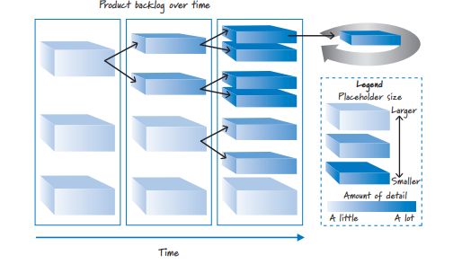
Overview of Chapter 5
If the product backlog is large, this provides the development team very little detail.
If the product backlog is smaller, the development team a lot of detail to work with.

Slide 3

Using Conversations in User Stories
Communication is key!
Scrum does not replace documents, but is simply just a tool.

Slide 4
Progressive Refinement
The primary goal of progressive refinement is to ensure that the backlog items are well-defined, appropriately estimated, and prioritized for upcoming sprints.backlog items are well-defined, appropriately estimated, and prioritized for upcoming sprints.
Progressive refinement is a critical practice in Scrum that fosters collaboration, adaptability, and continuous improvement throughout the project lifecycle. By investing time and effort in refining backlog items, the Scrum Team can enhance clarity, reduce risk, and deliver greater value to stakeholders.

Slide 5
What Are User Stories?
During refinement sessions, user stories are elaborated and broken down into smaller, more manageable tasks or sub-stories. This helps ensure that each backlog item is sufficiently detailed and understood by the development team.
User stories are concise, simple descriptions of a feature told from the perspective of the person who desires the new capability, usually a user or customer of the system. They typically follow a specific template: "As a [role], I want [feature] so that [benefit]." These stories help agile development teams understand the needs of the end-users and focus on delivering value incrementally.

Slide 6
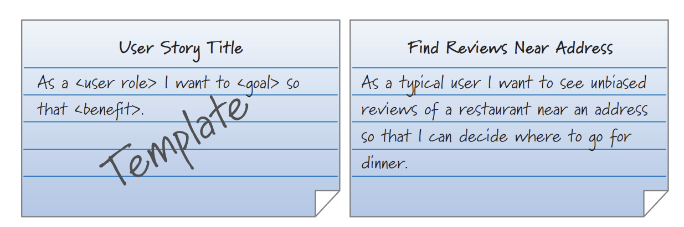
What are User Stories?
Card

Slide 7
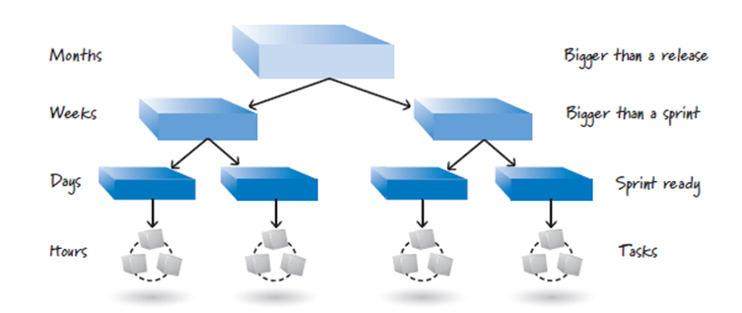
Level of Detail
Allows for higher-level planning and progressive refinement
Large
Epics
Encompass the big picture
May span an entire release or multiple releases
Placeholder for more detailed stories
Medium
Features
Too big for a single sprint
Small
Sprintable/implementable stories
Tasks
How to build, not what to build
Do not include in user stories

Slide 8
INVEST in Good Stories
Independent
Stories should not be overly dependent on each other.
Dependence hinders prioritization.
Negotiable
Should leave room to negotiate details.
Stories should address what and why, not how.
Valuable
Should be valuable to customer, user, or both.
All stories in the backlog must be valuable from the product owner’s perspective.
Estimatable
Estimates provide an indication of size,effort, and cost.
Cost can affect priority in the backlog.
Can indicate if additional refinement is required.
Sized Appropriately
Current work should be small to allow for multiple stories per sprint.
Future work can remain large until it is appropriate to break it down for current work.
Testable
Pass or fail
Should have good acceptance criteria
INVEST is a method of validating if stories are fit for their intended use

Slide 9
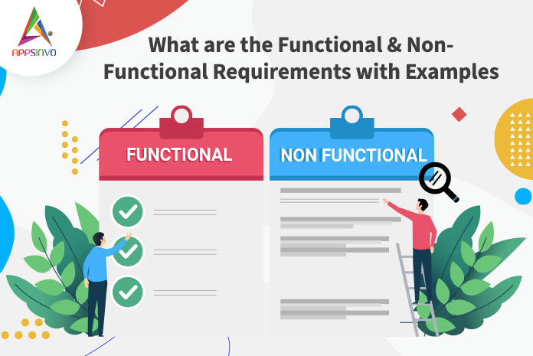
Nonfunctional Requirements
Nonfunctional Requirements should most often be part of a team's definition of done, while knowledge acquisition activities should be balanced against their value.

Slide 10
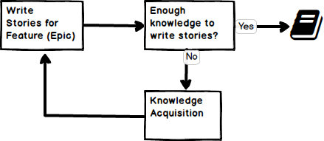
Knowledge-Acquisition Stories
Examples of knowledge acquisition are numerous, some may be : reading, studying, attending classes, searching online, asking questions, etc.

Slide 11
Gathering User Stories in Agile
User-Story-Writing Workshops: Engaging users as part of the development team to brainstorm business value and create user story placeholders.
Role Analysis: Beginning with defining user roles to craft stories that represent the needs and functionalities desired by the users.
Persona Creation: Developing characters like "Lilly" to represent user types for more personalized story creation.
Story Mapping: Decomposing high-level user activity into workflows using the concept of epics, themes, and stories to provide a two-dimensional backlog visualization.

Slide 12
Finalizing Agile Requirements
Scrum vs. Traditional: Emphasizing the dynamic treatment of requirements as product backlog items within Scrum, contrasting with sequential project approaches.
Progressive Elaboration: Using card, conversation, and confirmation to refine user stories in a just-in-time manner, ensuring they are ready for development sprints.
INVEST Criteria: Ensuring user stories are Independent, Negotiable, Valuable, Estimable, Small, and Testable for optimal Scrum workflow.
Requirement Visualization: Utilizing story mapping as a complement to workshops for better visualization and prioritization of stories within the product backlog.

